Slide 1
Business Process Engineering
Sobia.Iftikhar@nu.edu.pk Week 01
GCR: nciamel BSE-6B
GCR: 55qb6ki BSE-6A

Slide 2
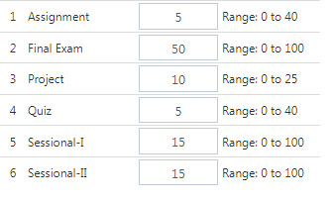
Marks Distribution

Slide 3
Course Outline
Business process management
Manufacturing and services processes
Lean processes Improvement workshop techniques
Modelling and charting tools
Business process outsourcing
Re-engineering and improvement cases

Slide 4
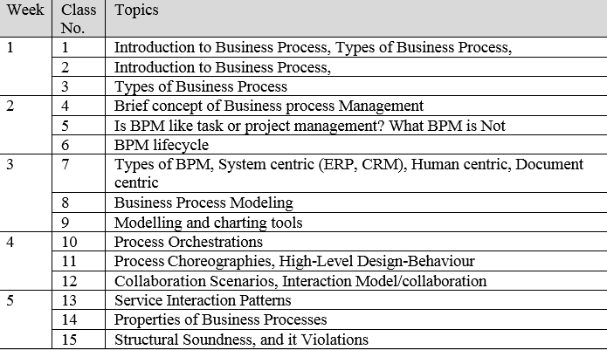
Course Description

Slide 5
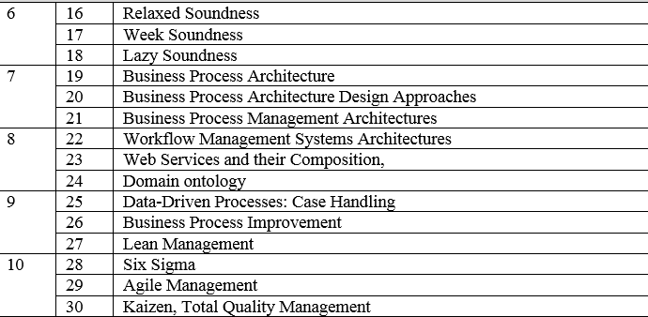
Course Description

Slide 6
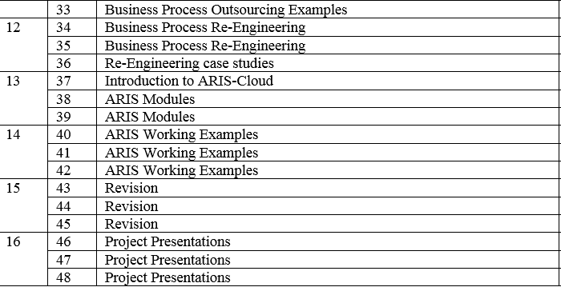
Course Description

Slide 7
What is Business Process?
A business process is defined as a series of tasks or a set of activities performed by a group of stakeholders to achieve an organizational goal
The processes are performed by people or systems in a structured manner to attain a pre-defined objective.
A company can reach its business goals in an efficient and effective manner only if people and other enterprise resources, such as information systems, work together well.
It is the fundamental building block for several related ideas such as business process management, process automation, etc.
it’s essential to understand why they are so important to your business.

Slide 8
To Short
Business Process is a set of tasks that directly or indirectly help your business provide the products/services to the customer.
Processes are the core of any business.
Everyday productivity of employees and long term growth of the business is determined by how well you have managed your business processes.

Slide 9
Why are business processes important?
It saves time
Time is money’ is being used since ages and is still relevant. When your business processes are aligned and crystal clear, you can save a lot of time for your employees and customers. Time is precious for the customers, and when you are able to deliver your promises in time,
Reduces Opportunity cost
Increases the efficiency
It may sound like you are missing big benefits and making a bad choice that can hurt a business. In reality, the opportunity cost is evaluating which is the best choice in a given situation and why
When everyone in the organization knows what they are supposed to do chronologically, it decreases a lot of redundancies and increases the efficiency of the whole organization.

Slide 10
Example
Example 1 – Purchasing Inventory vs Hiring More Employees
There may arise a situation in your business where you have to make a decision between buying new inventory and hiring new employees to tackle a rise in demand. While the rising demand will require you to purchase more inventory, hiring new employees is a long-term gain as it can boost the production capabilities of a business.
However, let us say there is a sudden influx of a new trend in the market. If you want to cash in on this trend, it is ideal to stock the required items quickly to earn as much revenue as possible until this trend lasts. On the other hand, if you decide to hire new employees to increase your productivity, you may not be able to meet your requirements due to urgency and a lack of time. Training new employees and helping them align with the business objective will take time and in the meanwhile, the trend may die down. The opportunity cost of hiring new employees in this situation is high and not a decision business owners would take.

Slide 11
Examples of Business Process
Here is a simplified example of how Business Process looks like.
1. Industry: Marketing
Company type: Ad agency
Process: Ad creation
Marketing agency processes can be a bit tricky as there is more qualitative output to be delivered. Here are the steps of an ad creation process:
Understanding client requirements
Brainstorming idea for the ad
Preparing a campaign
Pitching the idea to the client
Getting the approval
Making necessary changes
Providing the deliverables

Slide 12
Examples of Business Process
2. Industry: Information Technology
Company type: SaaS tool
Process: Developing the product
SaaS industry is booming and the solutions provided by these companies are value and utility-driven. Here’s how the process of developing the product looks like:
Understanding market demand
Finalizing a product outline
Programming the backend
Coordinate with the designer to program
The front end and the UX
Preparing an Onboarding experience
Testing the product internally
Solving bugs and errors
Running a beta test
Taking feedbacks from the users
Improve further

Slide 13
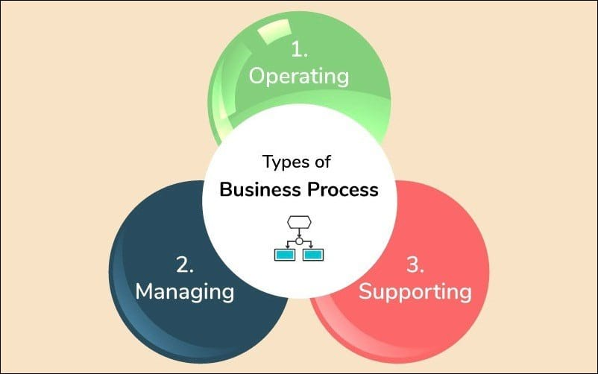
Types of Business Process
Management processes
Operational Processes
Supporting Processes

Slide 14
Management processes
The processes that plan, organize, coordinate and control all the functions of the business fall under managing processes.
These processes are goal-oriented. It includes helping and motivating your team to achieve their targets.
These processes also help in forming a direction for the further growth of your business. Regulating day to day tasks, teaching employees how to complete a task effectively, launching a new product, etc.
E.g., CEOs, managers, and top-level management are generally involved in management processes.
The processes that govern the operation of a system. Typical management processes include "corporate governance" and "strategic management".
The framework of rules and practices by which a board of directors ensures accountability, fairness, and transparency in a company's relationship with all its stakeholders (financiers, customers, management, employees, government, and the community).
A business strategy is the means by which an organization sets out to achieve its desired objectives. It can simply be described as long-term business planning.

Slide 15
Operational Processes
These processes are directly related to the fundamental values, vision, and mission of the business. They are also known as primary processes. You need to give extra attention to these processes as they are the primary revenue streams of the company. Filling the gaps and adding necessary improvements in these processes is essential. Once you complete the evaluation of these processes, it will have a direct impact on the growth of your business.
E.g., McDonald’s restaurant’s operating process would be taking orders, making food, and serving it to the customers.

Slide 16
Supporting Process
These are the processes that are not directly related to the delivery of the service or product to the customer. But they help the business create an environment where the primary processes can work better. That is where the name “supporting process” comes from. These are the processes under the accounting department, human resource management department, and any other department that supports the main functions of the business.
E.g., Hiring a new employee is a supporting function that helps the business expand.
Let’s take a look at this example of a call center to understand all the types of these processes.
Solving queries of clients on the call is the operating function. Managing the whole staff falls under managing processes. While the IT department assisting the employees at the time of any technical or hardware problems will be a supporting process.

Slide 17
Business process Engineering
Business process engineering is a way in which organizations study their current business processes and develop new methods to improve productivity, efficiency, and operational costs.
Business process engineering refers to the study of business processes so that they can be improved and streamlined for optimum efficiency in terms of both performance and cost.

Slide 18
Business process Engineering
The goal of business process engineering (BPE) is to define architectures that will enable a business to use information effectively.
Three different architectures must be analyzed and designed within the context of Business objective and goals.
Data architecture
Application architecture
Technology infrastructure

Slide 19
Business Process Engineering Approaches
Understanding the Present Mode of Operation (PMO).
Determining the Future Mode of Operation (FMO)
Gap Analysis and Transition Plan
Implementation.

Slide 20
What Makes Business Process Engineering a Success?
Your business process engineering team must be highly motivated, well-informed, and ready to think out of the box.
Know what business needs you seek to address. Do you hope to deliver an excellent customer experience? Are you seeking more cost-effective ways to get things done? Your goals inform the way in which you engineer your processes for efficiency.
Have the IT infrastructure you need. With business process engineering, IT infrastructure provides the tools and data that are needed.
Effective change management strategies help to get all the affected parties working together towards common goals.
Commitment to continuous improvement is a must. Whether you are setting up processes that will run for the first time or are streamlining, changing or revising existing systems, the actual results you achieve will point towards areas for further improvement.

Slide 21
Business Process Engineering includes:
Business Process Management
Business Process Modeling
Business Process Architecture
Business Process Improvement

Slide 22
Business process Management
The achievement of an organization’s objectives through the improvement, management and control of essential business processes.
Managing business processes is a huge challenge in most organizations. Many business owners assume that it is a huge expense or that it is only worth it for massive processes
Business process management (BPM) is also defined as an organizational discipline where a company takes a step back and looks at all of these processes in total and individually. It analyzes the current state and identifies areas of improvement to create a more efficient and effective organization.

Slide 23
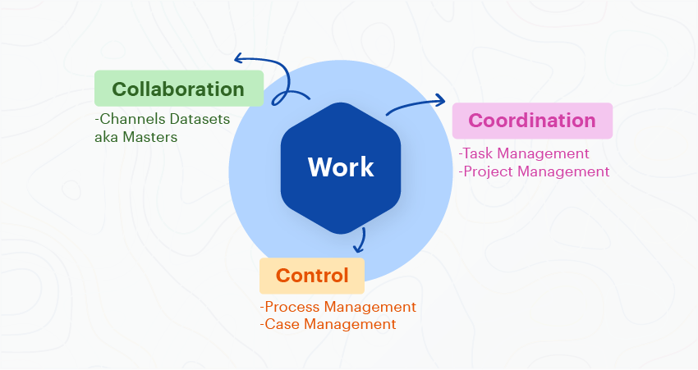
Business process Management
Business process management (BPM) is an organizational discipline where a company takes a step back and looks at all of these processes in total and individually. It analyzes the current state and identifies areas of improvement to create a more efficient and effective organization

Slide 24
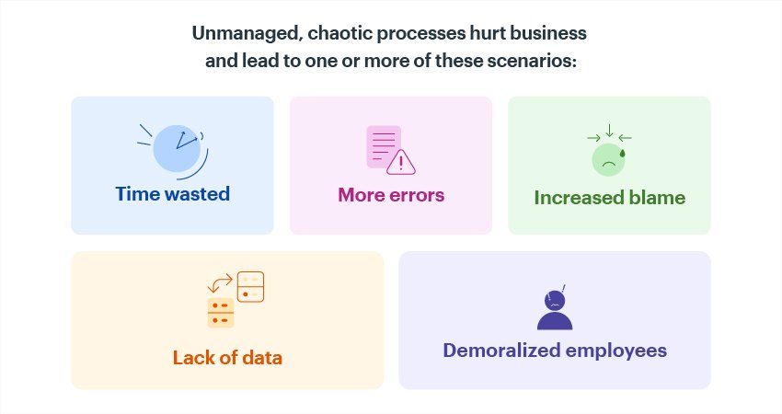
What is the Purpose of Business Process Management?

Slide 25
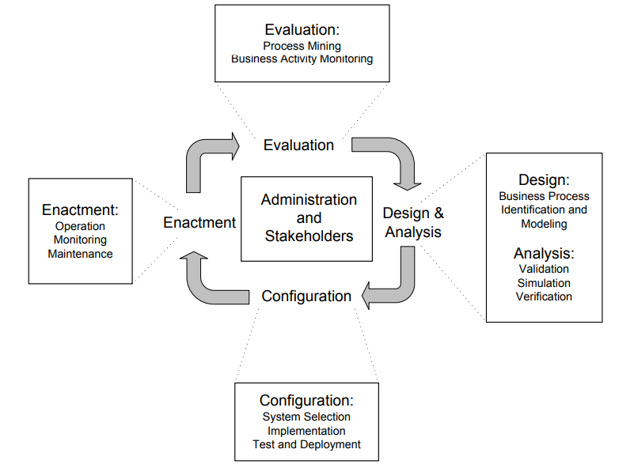
Business process lifecycle

Slide 26
Design and Analysis
The business process lifecycle is entered in the Design and Analysis phase, in which surveys on the business processes and their organizational and technical environment are conducted.
Based on these surveys, business processes are identified, reviewed, validated, and represented by business process models.

Slide 27
Configuration
Once the business process model is designed and verified, the business process needs to be implemented. There are different ways to do so. It can be implemented by a set of policies and procedures that the employees of the enterprise need to comply with.
The configuration of a business process management system might also involve transactional aspects. Transactions are a well-known concept from database technology, where a transaction manager guarantees that application programs run as transactions and obey the ACID principle: atomicitiy, consistency, isolation, and durability

Slide 28
Atomicity
Atomicity is a property that ensures that a database follows the all or nothing rule. In other words, the database considers all transaction operations as one whole unit or atom.
For example, user A wants to withdraw $50 from his account and then transfer it to the account of user B. Each transaction (withdrawing $50 from account A and transferring $50 to account B) is counted as separate. If the first transaction (withdrawing $50) fails because (say) the server crashes during the transaction, user A cannot transfer the money to user B.

Slide 29
Consistency
Consistency is a property ensuring that only valid data following all rules and constraints is written in the database.
For example, if user A wants to withdraw $1,000 from his account, but only has a balance of $500, consistency will prevent him from withdrawing money and the transaction will be aborted

Slide 30
Isolation
Isolation is a property that guarantees the individuality of each transaction, and prevents them from being affected from other transactions. It ensures that transactions are securely and independently processed at the same time without interference, but it does not ensure the order of transactions.
For example, user A withdraws $100 and user B withdraws $250 from user Z’s account, which has a balance of $1,000. Since both A and B draw from Z’s account, one of the users is required to wait until the other user transaction is completed, avoiding inconsistent data.
If B is required to wait, then B must wait until A’s transaction is completed, and Z’s account balance changes to $900. Now, B can withdraw $250 from this $900 balance

Slide 31
Durability
Durability is a property that enforces completed transactions, guaranteeing that once each one of them has been committed, it will remain in the system even in case of subsequent failures.
If a transaction is successful, all changes generated by it are stored permanently.
In the above example, user B may withdraw $100 only after user A’s transaction is

Slide 32
Enactment
During business process enactment, valuable execution data is gathered, typically in some form of log file. These log files consist of ordered sets of log entries, indicating events that have occurred during business processes. Start of activity and end of activity is typical information stored in execution logs.

Slide 33
Evaluation
. Execution logs are evaluated using business activity monitoring and process mining techniques. These techniques aim at identifying the quality of business process models and the adequacy of the execution environment.

Slide 34
Administration and Stakeholders
The business process domain is characterized by several types of stakeholders with different knowledge, expertise, and experience; these are classified into the following roles:
Chief Process Officer: Top level management.
Business Engineer : Must have a nontechnical educational background
Process Designer: Process designers are responsible for modelling business processes by communicating with business domain experts and other stakeholders
Process Participant:
Knowledge Worker
System Architect
Developers

Slide 35
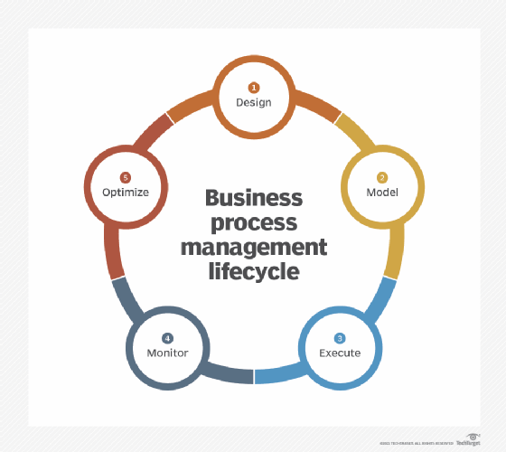
BPM lifecycle
BPM consists of several steps. Many BPM experts refer to these five:
Create a plan: (Primary , Secondary, Management )
Analyze the processes of your organization (qualitative, quantitative )
Design the ideal model
Implement
Monitor

Slide 36
What BPM is Not
BPM is not a software product
BPM is not Task Management

Slide 37
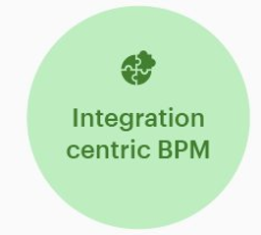
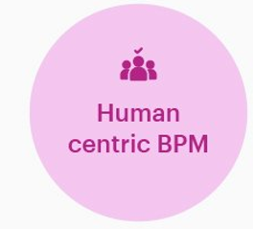
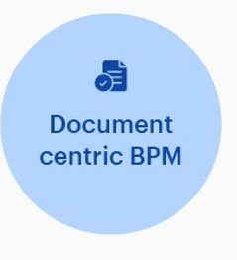
Types of BPM

Slide 38

1. Document-centric BPM
A document-centric process is one where a document like a contract or legal agreement is at the heart of that process. Document-centric processes define procedures for distributing, reviewing, and validating documents.
A good example would be the process for approving and signing customer contracts or contracts signed while procuring the services of external vendors.

Slide 39
2. Human-centric BPM
Human-centric processes are those that have the most involvement and interaction performed by humans. They are generally decision-based instead of rules-based processes; humans decide the process's path based on their decisions.
An example of a human-centric process in an organization is hiring new talent by the Human Resources team.
Human-centric-BPM
The decision-based nature of human-centric processes presents challenges where automation is concerned. Whereas automation teams are beginning to ramp up their use of intelligent automation, this type of automation is still very much in the experimental stage and not quite ready for prime time.

Slide 40

3. Integration-centric BPM
Integration-centric processes define the transfer of information and data between different systems without significant human intervention. These processes lend themselves very well to automation, increasing the speed of execution and limiting errors based on humans' decreased involvement.
Integration-centric-BPM
An excellent example of an integration-centric process is the connection between marketing tools like HubSpot or Marketo with sales-based CRMs (client relationship manager) like Salesforce or Siebel to transfer data on lead generation and engagement between those two systems.

Slide 41
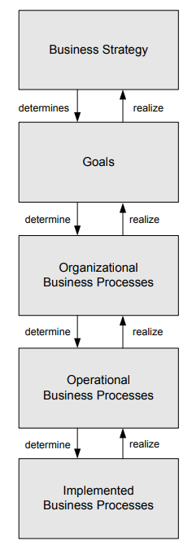
Levels of business processes: from business strategy to implemented business processes
At the highest level, the strategy of the company is specified, which describes its long-term concepts to develop
These goals can be organized, so that each goal can be divided into a set of subgoals. Reducing the cost for supplied materials is a sample goal
These business processes act as supplier or consumer processes
the activities and their relationships are specified
Implemented business processes contain information on the execution of the process activities and the technical and organizational environment in which they will be executed.

Slide 42
Intraorganizational Processes versus Process Choreographies
single organization. If there is no interaction with business processes performed by other parties, then the business process is called intraorganizational.
interact with business processes in other organizations, forming process choreographies. T

Slide 43
Here’s how a CRM system can help your business today.?

